Slide 1








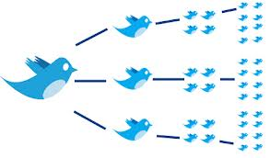


Document Similarity & Applications Analytics for Unstructured Data MSBA, Fall 2021 14th September
Dr. Anitesh Barua
David Bruton Jr. Centennial Chair Professor in Business
Distinguished Fellow, INFORMS Information Systems Society
University of Texas Distinguished Teaching Professor
Associate Director, Center for Research in e-Commerce
McCombs School of Business, University of Texas at Austin
Email: aniteshb@gmail.com

Slide 2
Document Similarity & Applications (i) Resonance Analysis (ii) Crowdsourced Recommendation Systems

Slide 3
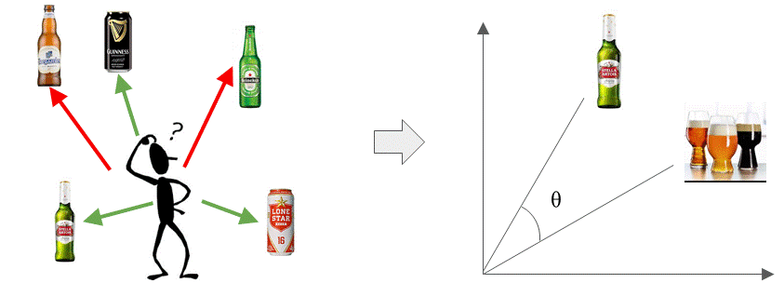
Assessing Document Similarity
Early applications: Document clustering/categorization & retrieval
Many business applications
E.g., which beers or movies are similar?
your competition in markets with lots of products
Useful for recommender systems – both conventional & crowdsourced
Understanding your competition in markets with lots of products
Myriad applications: Did a campaign resonate with the intended audience?
© Anitesh Barua, 2021

Slide 4
The Basic Idea
Start with a numerical representation of each document
Many ways to represent a document with numbers
Presence absence of each term (0/1)
Raw or scaled (normalized) frequency of each term
TF-IDF of each term in a document (be careful, not applicable everywhere)
Multiple ways to calculate similarity between the documents
Choice 1: Calculate Euclidean distances between documents
Choice 2: Calculate the % words that are common across the documents
Choice 3: Calculate the angle between the two document vectors (many variations are possible)
Choice 4: Use word embeddings (e.g., word2vec) and calculate similarity
© Anitesh Barua, 2021

Slide 5
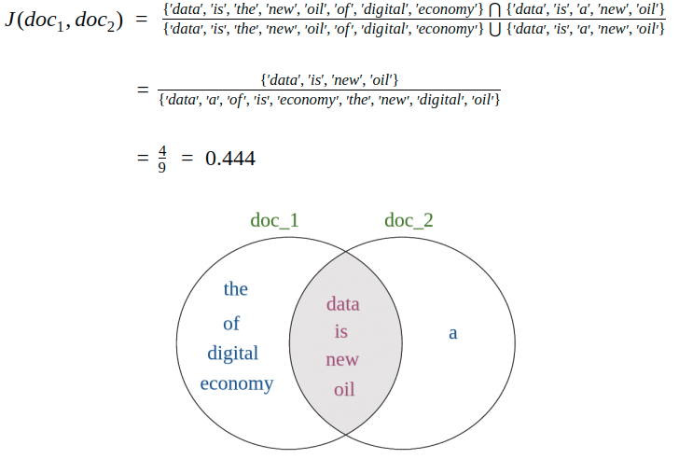
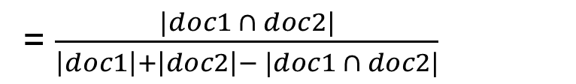

Jaccard Similarity
$$Jaccard\left(doc1, doc2\right)=\frac{|doc1 ∩doc2|}{|doc1 ∪doc2|}$$
= $\frac{|doc1 ∩ doc2|}{\left|doc1\right|+\left|doc2\right|− |doc1 ∩ doc2|}$
Doc1: Data is the new oil of the digital economy
Doc2: Data is a new oil
Source: B. Kanani

Slide 6
Angles Instead of Distances
n-dimensional space with n terms
A document (e.g., tweet) represented
by its coordinates in this term space
t ₂
d ₂
Doc 2
Term 2
d ₁
Doc 1
θ
t ₁
Term 1
t _{n}
Similarity between documents d₁ and d₂ (could also be a set of keywords) is the cosine of the angle Ɵ between them.
Score between 0 and 1.
Source: http://pyevolve.sourceforge.net/wordpress/?p=2497

Slide 7
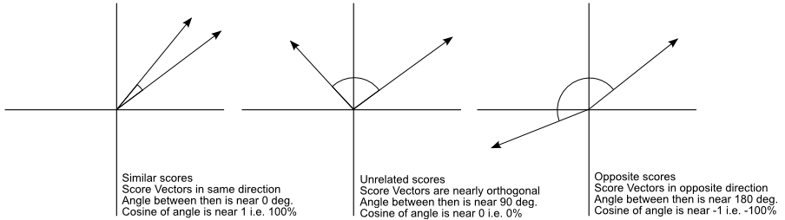
Similar vs. Unrelated Mentions
Ref document
or keywords
Social mention
Is this approach better than Euclidean distances?
Source: http://pyevolve.sourceforge.net/wordpress/?p=2497

Slide 8


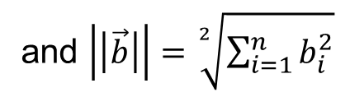
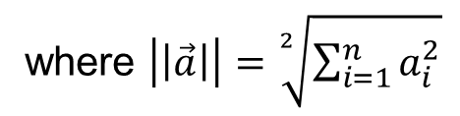

Basics Revisited…
Dot product of two vectors
$$\vec{a}.\vec{b}= \sum_{i=1}^{n}{a_{i} b_{i}}$$
n features, a_{i} and b_{i} can be tf, tf-idf, or other scores depending on application
But what exactly does a dot product mean geometrically?
$$\vec{a}.\vec{b}=|\left|\vec{a}\right||∗|\left|\vec{b}\right||∗cosθ$$
where $\left|\left|\vec{a}\right|\right|=\sqrt[2]{\sum_{i=1}^{n}{a_{i}^{2}}}$
and $\left|\left|\vec{b}\right|\right|=\sqrt[2]{\sum_{i=1}^{n}{b_{i}^{2}}}$
$$Or cosθ=\frac{\vec{a}.\vec{b}}{|\left|\vec{a}\right||∗|\left|\vec{b}\right||}$$

Slide 9
In Practical Terms ….
Cosine of angle between two vectors represented by documents d_{j} and d_{k}.
The denominator involves the lengths of the vectors.
What is the key advantage of cosine similarity over Euclidean distance?

Slide 10
Useful for Information Retrieval
Term frequencies
TF | D1 | D2 | D3 | D4
Who | 0 | 0 | 1 | 1
Wrote | 0 | 0 | 0 | 1
Wild | 1 | 1 | 1 | 1
Boys | 1 | 1 | 0 | 0
IDF = log(1/DF)
=log₁₀(1/.5)=.301
.602
0
.301
query = ‘who wrote wild boys’
doc1 (D1) = ‘Duran Duran sang Wild Boys in 1984.’
doc2 (D2) = ‘Boys don’t remain wild forever.’
doc3 (D3) = ‘Who brought wild flowers?’
doc4 (D4) = ‘It was John Krakauer who wrote In to the wild.’
Weights based
on document
frequency
Final TF_IDF weights
TF_IDF | D1 | D2 | D3 | D4 | Q
Who | 0 | 0 | .301 | .301 | .301
Wrote | 0 | 0 | 0 | .602 | .602
Wild | 0 | 0 | 0 | 0 | 0
Boys | .301 | .301 | 0 | 0 | .301
Similarity | D1 | D2 | D3 | D4
Query | .408 | .408 | .408 | .913*
Similarity(Doc1,Query) = (0+0+0+.301^2) / [(.301^2)^.5 * ((.301^2 + .602^2 + .301^2)^.5)]
= .0906 / (.301*.7373) = .408

Slide 11
Application 1: Assessing Relevance and Resonance
How do we know if our campaign/message is having an impact on what people are talking about?
E.g., political campaign
Product or brand campaign
How companies describe themselves vs. how employees feel
A simple approach: How “far” are the social mentions from the message?
© Anitesh Barua, 2021

Slide 12
Application 2: Crowdsourced Recommender Systems
Why bother about recommender systems?
The long tail of products
Matching products with customer preferences

Slide 13

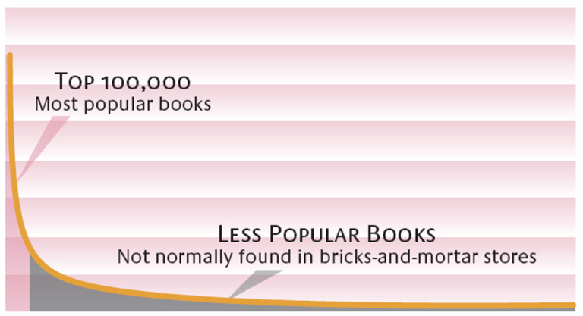
Enabling Forces: The Long Tail*
Sales
High Popularity Low
Customer preferences are diverse
Endless variety of products available
Uncertainty in the tail region
Long tail will not work without recommenders and/or word-of-mouth
© Anitesh Barua, 2021
Source: Brynjolfsson, Hu and Smith; *Chris Anderson

Slide 14
Crowdsourced Recommender Systems
The case of hotel search
Web sites (e.g., hotels.com, orbitz.com, Tripadvisor.com) show by one criterion
Rating
Stars
Location
Price
But most customers consider multiple attributes
How can we provide a better match with customer preferences?

Slide 15
A Lot Better than a Single Criterion
Obtain user inputs, e.g.,
Romantic, ambience, mid-priced, beachfront
Business, budget, wi-fi, convenience
Crowdsource!
Extract large # conversations about hotels
Now becomes a document retrieval problem
E.g., query: Romantic, ambience, mid-price, beachfront
Calculate cosine similarity between query & mentions
Rank mentions by cosine similarity
Perform sentiment analysis to find most positive reviews
Make recommendations

Slide 16
Additional Data
Augment text with:
Vicinity: E.g., Microsoft Virtual Earth Interactive SDK (software development kit)
Proximity: “near a beach”, “near downtown”, “near public transportation” with user geotagging & automatic classification of satellite images of areas near each hotel (e.g., geonames.org)
Additional information become extra dimensions for cosine similarity analysis
Overall results: Superior to those provided by any of the major hotel search sites

Slide 17
Observations on Recommender Systems
Recommendations may be from the tail region (increases product diversity)
If you know of a product, a recommender system can find products
that are more affordable
which people like for the same reasons
Widespread use of recommenders can shift the demand curve
For the long tail idea, see https://medium.datadriveninvestor.com/who-is-your-competitor-in-the-era-of-the-long-tail-d0ac24fedde8
Details of a crowdsourced recommender system: https://towardsdatascience.com/a-recommender-system-based-on-customer-preferences-and-product-reviews-3575992bb61

Slide 18
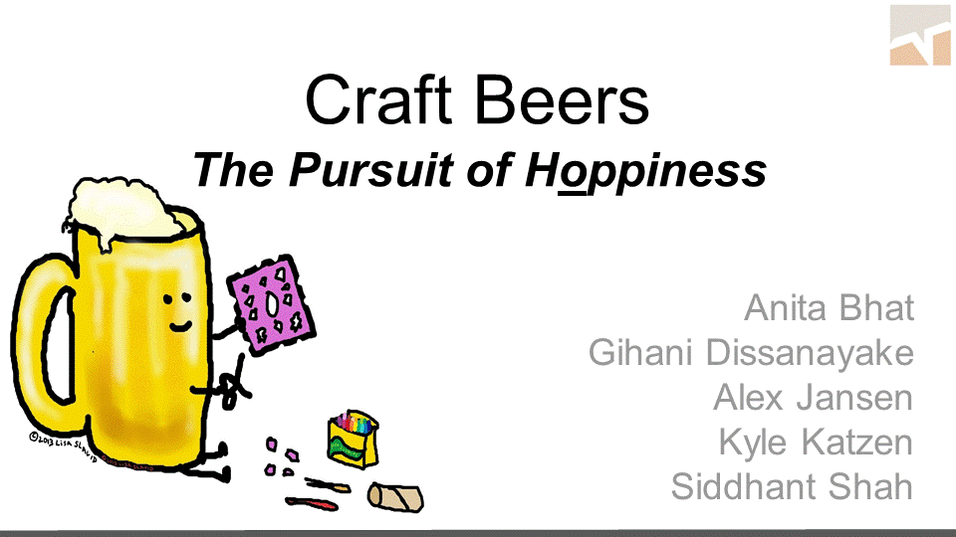

Slide 19
